Slide 1
Module 4 Azure Active Directory
Section 3 - User Sign-in methods
June 2018

Slide 2
Agenda - Module 4 - Section 3 : User Sign-in methods
01
AAD Authentication models Overview of each Authentication choices / Sign-in options
Main considerations for helping to choose are listed here.
02
AAD Authentication based on Password Hash Synchronization (PHS) Description of the Azure AD authentication principle based on the password synchronization.
03
AAD Authentication based on Pass-Through Authentication (PTA) A close look to this new authentication method that enables hybrid Azure AD tenants to use on-premises Active Directory to validate users for cloud resources (without the use of AD FS)
04
AAD Authentication based on seamless Single Sign-On (seamless SSO) when combined with PHS or PTA Detailed authentication flow of this new authentication method that can be optionally combined with PHS or PTA. Then Domain joined PC on the corporate network can use Kerberos authentication against Azure AD (using effective SSO)
05
AAD Authentication based on a AD FS Federation Trust Quick overview about federated authentications, this topic is deeply developped in the next section (section 4)
06
Best practices The main points to takeaway
Notes:
AAD stands for Azure Active Directory

Slide 3
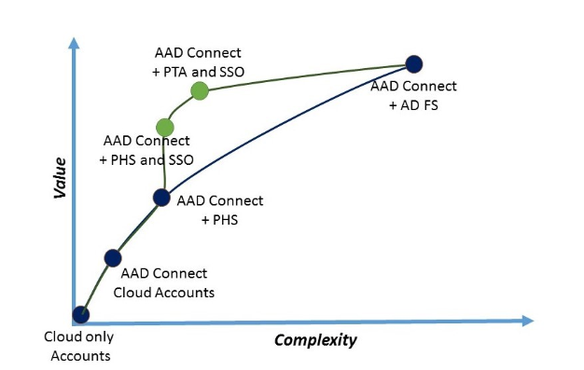
Azure AD Authentication option (the full picture)
Cloud only accounts:
User accounts are maintained and authenticated in Azure AD.
AAD Connect / Cloud Accounts:
You can use Azure AD Connect to sync user accounts into Azure AD so the login id (usually the user’s email address) is the same, but the users must maintain their own passwords in Azure AD.
AAD Connect + PHS (user sign-in based on PHS):
When you turn on the password hash synchronization optional feature in Azure AD Connect, the user password hashes stored in your on-premises Active Directory will be synchronized into Azure AD, thus enabling same sign-on.
If combined with Seamless SSO feature
Domain joined PC on the corporate network can use Kerberos authentication against Azure AD (using effective SSO)
AAD Connect + PTA (user sign-in based on PTA):
PTA enables users to login to cloud resources by validating their password against their on-premises local Active Directory (without the need to install AD FS). The used authentication protocols are the ones available on-premises (NTLM/Kerberos)
No password hashes stored in Azure AD / All authentication happens against on-prem AD
Can be also combined with Seamless SSO
When users are accessing applications on their corporate machines inside their corporate network, they don't need to type in their passwords to sign in.
AAD Connect + AD FS:
The most complete and most complex solution, this combination will provide SSO (single sign-on) to Azure AD. All authentications happens against on-prem AD.
Azure AD Authentication choices
Notes:
Azure Active Directory (Azure AD) Connect allows your users to sign in to both cloud and on-premises resources by using the same passwords.
This section describes key concepts for each identity model to help you choose the identity that you want to use for signing in to Azure AD.
If you’re already familiar with the Azure AD identity model and want to learn more about a specific method, see the appropriate link:
Password hash synchronization with Seamless Single Sign-on (SSO)
Pass-through authentication with Seamless Single Sign-on (SSO)
Federated SSO (with Active Directory Federation Services (AD FS))
Federation with PingFederate

Slide 4

Recall: : The Azure AD Identity Models in one slide
New Identity Models
There are 5 design options to consider for enabling users to authenticate to cloud services.
Managed Identities
Federated Identities
Managed Identities
Pure Cloud Identity
Synchronized Identity (Password Hash Sync)
Federated Identity
Pass-Through Authentication
AAD Seamless SSO (is combined with PHS or PTA)
Azure Active Directory
Azure Active Directory
Azure Active Directory
Azure Active Directory
Azure Active Directory
Azure AD App Proxy Connector
Directory Sync and Password Sync
Directory Sync
Federation
Directory Sync
Directory Sync
Kerberos AuthN
Active Directory
Active Directory
Active Directory
Active Directory
Independent cloud identity
Single identity, enabling a sign-on like experience with password hash sync
Single identity, enabling single sign-on and additional flexibility
Single identity, enabling single sign-on in some scenarios and additional flexibility
True Single Sign-On (SSO) without ADFS.
Password stored in the cloud
Hash of Password hash stored in the cloud
Password stored on-premises
Password stored on-premises
Is combined with PHS or PTA
Notes:
As part of setting up a Common Identity, there are 5 design options to consider for enabling users to authenticate to cloud services:
Cloud Identity: the user identities and associated passwords reside in the cloud and no synchronization takes place with the on-premises Active Directory. In this case, authentication always occurs in the cloud and the users must use a separate password from the one used on-premises. This is the simplest scenario as there is no need to synchronize user identities from the on-premises Active Directory domains to the cloud.
Synchronized Identity: the user identities and associated passwords are synchronized from the on-premises Active Directory to the Microsoft Azure Active Directory. In this case, the same password can be used to authenticate the user either in the cloud or on-premises depending on what resource is being accessed. This scenario requires the use of the Azure Active Directory Synchronization Service (AAD Sync) with password hash synchronization enabled.
Federated Identity: all authentication is retained on-premises and all passwords are stored on-premises only. All authentication traffic is redirected from Azure Active Directory to the on-premises Active Directory Federation Service (AD FS), which authenticates the user against a trusted Active Directory domain. This scenario requires the use of a federation service provider such as Active Directory Federation Service (AD FS) in addition to AAD Sync.
Pass-through Authentication
What is Azure Active Directory pass-through authentication?
Allowing your users to use the same credentials (passwords) to sign in to both on-premises resources and cloud-based services benefits them and your organization. Users have one less password to remember, which provides a better user experience. It also reduces the chances that users will forget how to sign in. Your help-desk costs then decrease, because password-related issues typically consume the most support resources.
Azure AD Seamless SSO
Azure Active Directory Seamless Single Sign On (Azure AD Seamless SSO) provides true single sign on for users signing in on their corporate desktops connected on the corporate network. When enabled, users won't need to type in their passwords to sign in to Azure AD, and in most cases, even type in their usernames. This feature provides your users easy access to your cloud-based services without needing any additional on-premises components.+
Seamless SSO can be enabled via Azure AD Connect and can be combined with either password synchronization or pass-through authentication.

Slide 5
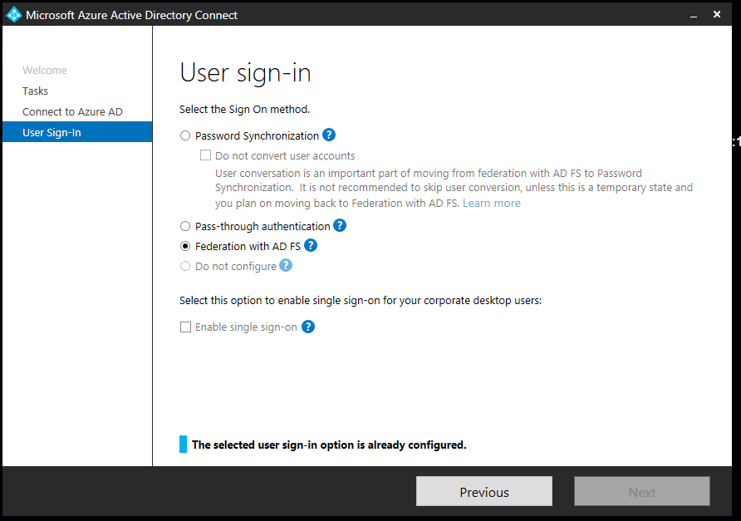
User sign-in choices exposed by Azure AD Connect
Password Hash Synchronization
Which can be combined with seamless SSO
Pass-Through Authentication
Which can be combined with seamless SSO
« Federation with AD FS » :
In case where AD FS is configured/managed through Azure AD Connect.
«Do not configure » :
In case where AD FS is configured / managed outside of/independently of Azure AD Connect. Or if a 3party federation solution is used.
Notes:
https://docs.microsoft.com/en-us/azure/active-directory/connect/active-directory-aadconnect-user-signin
Password hash synchronization with Seamless Single Sign-on (SSO)
Pass-through authentication with Seamless Single Sign-on (SSO)
Federated SSO (with Active Directory Federation Services (AD FS))

Slide 6
Considerations for choosing authentication options
Consideration | Password Hash Synchronization | ADFS | Pass-through Authentication
Where does the authentication happen? | In the cloud | On-premises | On-premises
Where does the user enter the credentials? | In the cloud | On-premises (through proxy in DMZ) | In the cloud (transmitted securely to on-premises agent)
Is there any on-premises infrastructure needed beyond Azure AD Connect? | No | Yes – At least 2 ADFS servers and 2 proxies in DMZ | Yes – 1 or more lightweight agents that can be installed on any existing servers (including DCs) with no DMZ requirements
Do my users get single sign-on to cloud resources from domain-joined devices within company network? | Yes when combined with Seamless SSO | Yes | Yes when combined with Seamless SSO

Slide 7
Considerations for choosing auth options
Consideration | Password Hash Synchronization | ADFS | Pass-through Authentication
What login types does it support? | U/P, Win10/Hello | U/P, WIA, Cert-based auth, SmartCard, | U/P
What MFA options do I have? | Azure MFA | Azure MFA, Azure On-premises MFA, 3rd party MFA (RSA, Safenet, HID Global, Symantec,…) | Azure MFA
What Conditional Access options do I have? | Azure AD Conditional Access | Azure AD Conditional Access as well as additional on-premises levers | Azure AD Conditional Access
Does it support alternate login ID? | Yes | Yes | Not Currently
Does it support legacy application & EAS clients? | Yes | Yes | No
Notes:
U/P : User + Password
WIA : Windows Integrated Authentication
MFA : Multi-Factor Authentication

Slide 8
Azure AD Connect : User sing-in option for PHS
Password Hash Synchronization
Optional :Which can be combined with seamless SSO
Notes:
https://docs.microsoft.com/en-us/azure/active-directory/connect/active-directory-aadconnect-user-signin
Password hash synchronization with Seamless Single Sign-on (SSO)
Pass-through authentication with Seamless Single Sign-on (SSO)
Federated SSO (with Active Directory Federation Services (AD FS))

Slide 9
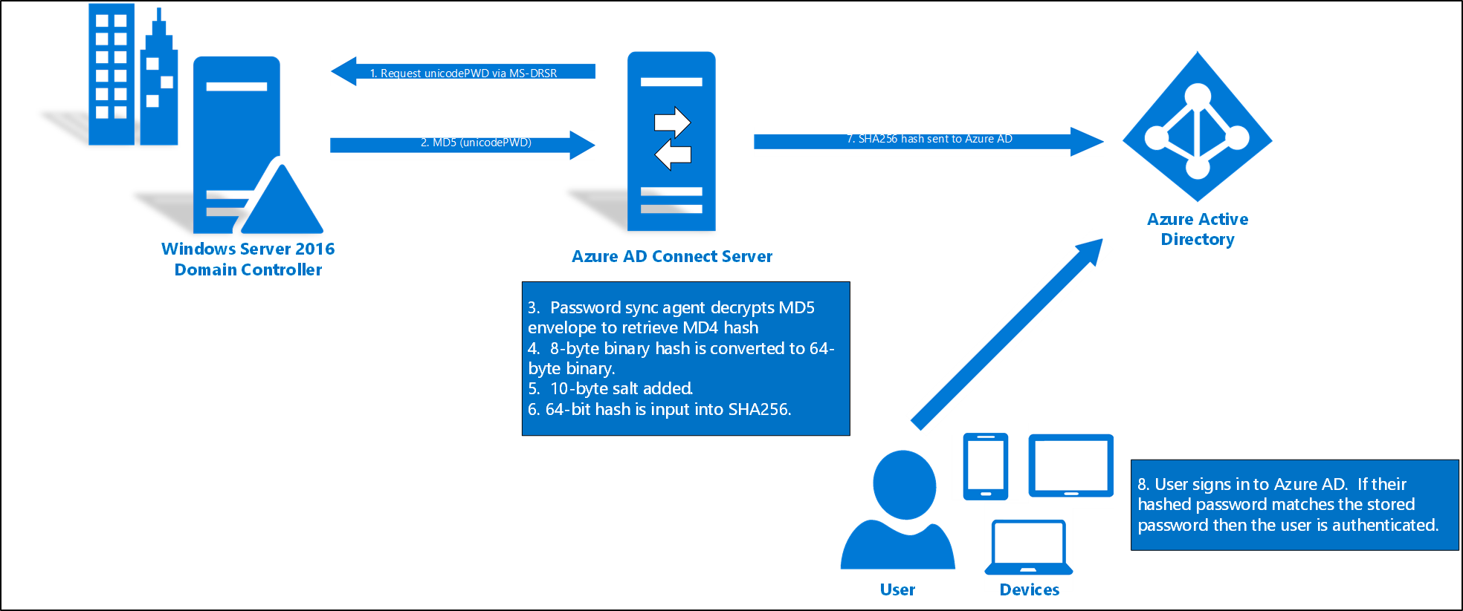
How password hash synchronization works
1. Request unicodePWD via MS-DRSR
7. SHA256 hash sent to Azure AD
2. MD5 (unicodePWD)
Note : Steps 1 to 7 have been covered in section related to the Password synchronization (in fact Password Hash synchronization).
Here the focus is just the authentication step (step 8 ).
8. When a user attempts to sign in to Azure AD and enters their password, the password is run through the same MD4+salt+PBKDF2+HMAC-SHA256 process (as the one used during the password synchronization) . If the resulting hash matches the hash stored in Azure AD, the user has entered the correct password and is authenticated.
Notes:
Recall : Password hash synchronization is a feature used to synchronize user passwords from an on-premises Active Directory instance to a cloud-based Azure AD instance. Use this feature to sign in to Azure AD services like Office 365, Microsoft Intune, CRM Online, and Azure Active Directory Domain Services (Azure AD DS). You sign in to the service by using the same password you use to sign in to your on-premises Active Directory instance.
Reference : https://docs.microsoft.com/en-us/azure/active-directory/connect/active-directory-aadconnectsync-implement-password-hash-synchronization
Every two minutes, the password hash synchronization agent on the AD Connect server requests stored password hashes (the unicodePwd attribute) from a DC via the standard MS-DRSR replication protocol used to synchronize data between DCs. The service account must have Replicate Directory Changes and Replicate Directory Changes All AD permissions (granted by default on installation) to obtain the password hashes.
Before sending, the DC encrypts the MD4 password hash by using a key that is a MD5 hash of the RPC session key and a salt. It then sends the result to the password hash synchronization agent over RPC. The DC also passes the salt to the synchronization agent by using the DC replication protocol, so the agent will be able to decrypt the envelope.
After the password hash synchronization agent has the encrypted envelope, it uses MD5CryptoServiceProvider and the salt to generate a key to decrypt the received data back to its original MD4 format. At no point does the password hash synchronization agent have access to the clear text password. The password hash synchronization agent’s use of MD5 is strictly for replication protocol compatibility with the DC, and it is only used on premises between the DC and the password hash synchronization agent.
The password hash synchronization agent expands the 16-byte binary password hash to 64 bytes by first converting the hash to a 32-byte hexadecimal string, then converting this string back into binary with UTF-16 encoding.
The password hash synchronization agent adds a per user salt, consisting of a 10-byte length salt, to the 64-byte binary to further protect the original hash.
The password hash synchronization agent then combines the MD4 hash plus the per user salt, and inputs it into the PBKDF2 function. 1000 iterations of the HMAC-SHA256 keyed hashing algorithm is used.
The password hash synchronization agent takes the resulting 32-byte hash, concatenates both the per user salt and the number of SHA256 iterations to it (for use by Azure AD), then transmits the string from Azure AD Connect to Azure AD over SSL.
When a user attempts to sign in to Azure AD and enters their password, the password is run through the same MD4+salt+PBKDF2+HMAC-SHA256 process. If the resulting hash matches the hash stored in Azure AD, the user has entered the correct password and is authenticated.
Note
The original MD4 hash is not transmitted to Azure AD. Instead, the SHA256 hash of the original MD4 hash is transmitted. As a result, if the hash stored in Azure AD is obtained, it cannot be used in an on-premises pass-the-hash attack.

Slide 10

Pass-through Authentication (PTA) - Overview
Pass-through authentication (Azure AD Connect) enables users to login to cloud resources by validating their password against their on-premises local Active Directory (without the need to install AD FS). The used authentication protocols are the ones available on-premises (NTLM/Kerberos)
ON PREMISES
Azure AD
AuthN Agent
Active Directory
AuthN agent
Great user experience
Secure and compliant
Easy to deploy & administer
Same passwords to authenticate to cloud-based and on-premises apps
Integrated with Self-Service Password Reset
Passwords remain on-premises
No DMZ and no inbound firewall requirements
Agent-based deployment
No complex on-premises deployments or network config
Zero management overhead
Integrated with Smart Lockout, Identity Protection and Conditional Access
Notes:
Reference: https://docs.microsoft.com/en-us/azure/active-directory/connect/active-directory-aadconnect-pass-through-authentication-quick-start
Pass-through authentication (Azure AD Connect) enables users to login to cloud resources by validating their password against their on-premises local Active Directory. This feature allows customers that cannot (or don’t want to) store passwords in the cloud (and therefore can’t use the option of “password sync”) to onboard Azure AD without having to modify their corporate network infrastructure and install products such as ADFS or similar 3rd party federation solutions. In addition to authentication, it enables seamless single sign-on from Windows devices that now can be enabled for the “password sync” option too
Overview
Pass-through Authentication allows your users to sign in to both on-premises and cloud-based applications using the same passwords.
This feature is an alternative to Azure AD Password Hash Synchronization, which provides the same benefit of cloud authentication to organizations that don't permit send users' passwords, even in a hashed form, outside their internal boundaries.
You can combine Pass-through Authentication with the Seamless Single Sign-On feature, when your users are accessing applications on their corporate machines inside your corporate network, they don't need to type in their passwords to sign in.
Feature highlights
Supports sign-in on web browser-based applications and into Microsoft Office client that use modern authentication.
Sign-in usernames can be either the on-premises default username (userPrincipalName) or another attribute configured in Azure AD Connect (known as Alternate ID).
The feature works seamlessly with conditional access features such as Multi-Factor Authentication (MFA) to help secure your users.
Integrated with cloud-based self-service password management, including password writeback to on-premises Active Directory and password protection by banning commonly used passwords.
Multi-forest environments are supported if there are forest trusts between your AD forests and if name suffix routing is correctly configured.
It is a free feature, and you don't need any paid editions of Azure AD to use it.
It can be enabled via Azure AD Connect.
It uses a lightweight on-premises agent that listens for and responds to password validation requests.
Installing multiple agents provides high availability of sign-in requests.
It protects your on-premises accounts against brute force password attacks in the cloud.

Slide 11
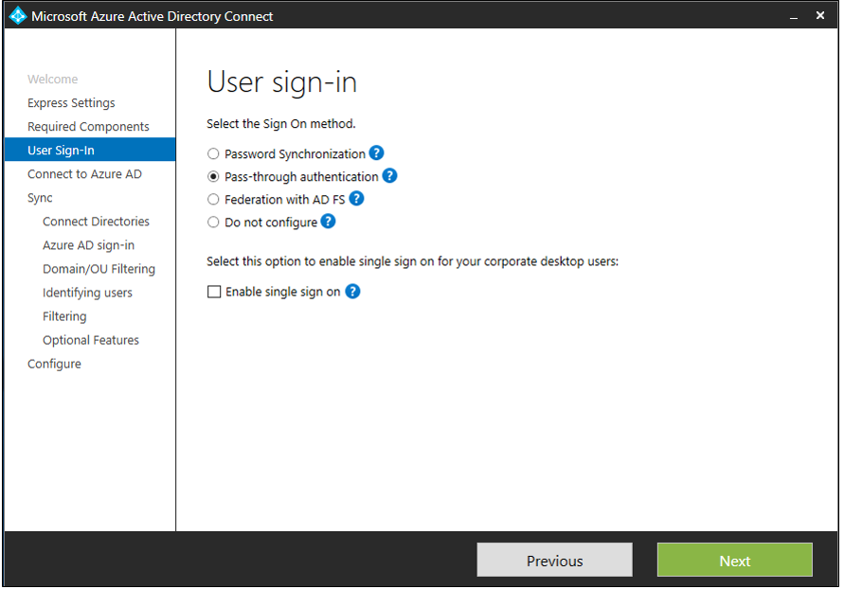
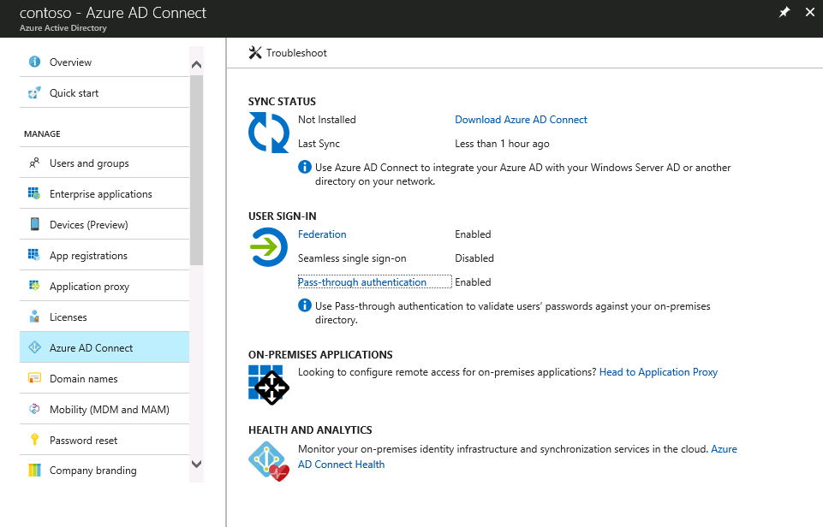
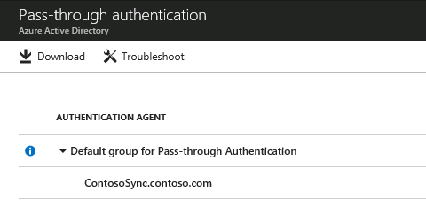
Configuration
Can be enable during Azure AD Connect setup or If you have already installed Azure AD Connect select Change user sign-in task.
https://docs.microsoft.com/en-us/azure/active-directory/connect/active-directory-aadconnect-pass-through-authentication-quick-start
The first PTA agent always deploys on the AAD Connect server itself
Remember to deploy more (3 seems to be the magic number)
Install additional Authentication Agents on a server other than the one running Azure AD Connect and the first Authentication Agent.
Note : PTA doesn’t load balance traffic between PTA agents today …
Notes:
Reference: https://docs.microsoft.com/en-us/azure/active-directory/connect/active-directory-aadconnect-pass-through-authentication-quick-start

Slide 12
Azure AD Connect : User sing-in option for PTA
Pass-Through Authentication
Optional : can be combined with seamless SSO
Notes:
https://docs.microsoft.com/en-us/azure/active-directory/connect/active-directory-aadconnect-user-signin
Password hash synchronization with Seamless Single Sign-on (SSO)
Pass-through authentication with Seamless Single Sign-on (SSO)
Federated SSO (with Active Directory Federation Services (AD FS))

Slide 13
How Pass-through authentication (PTA) works
Azure AD completes sign-in
10
2
Azure AD
4
Credentials encrypted (with public key) & queued
User sent to Azure AD for sign-in
3
User provides credentials
AuthN Agent picks up queued request
5
Attempt to sign in to app
1
11
If sign-in is successful, access the app
ON-PREMISES
Agent decrypts credentials with private key
9
Agent responds to Azure AD
6
AD responds to Agent
8
App
7
Agent validates credentials with AD
Active Directory
AuthN PTA Agent

Slide 14
PTA - Smart Lockout
Smart Lockout protects against brute force password attacks.
Gain instant protection for identities
Customizable. Lockout bad actor after X failed password attempts
After certain failed sign-in attempts (Lockout Threshold), starts Lockout Duration – any sign attempts from the attacker during the Lockout Duration are rejected.
Recommended settings for AD and Azure AD Lockout policies:
Azure AD’s Lockout Threshold is less than AD’s Account Lockout Threshold.
Azure AD’s Lockout Duration is longer than AD’s Reset Account Lockout Counter After.
More Information:
https://docs.microsoft.com/en-us/azure/active-directory/connect/active-directory-aadconnect-pass-through-authentication-smart-lockout
Notes:
Smart Lockout works by keeping track of failed sign-in attempts, and after a certain Lockout Threshold, starting a Lockout Duration.
Because Pass-through Authentication forwards password validation requests onto your on-premises Active Directory (AD), you need to prevent attackers from locking out your users’ AD accounts.
The default Lockout Threshold is 10 failed attempts, and the default Lockout Duration is 60 seconds.
To ensure that your users’ on-premises AD accounts are well protected, you need to ensure that:
Azure AD’s Lockout Threshold is less than AD’s Account Lockout Threshold. We recommend that you set the values such that AD’s Account Lockout Threshold is at least two or three times Azure AD’s Lockout Threshold.
Azure AD’s Lockout Duration (represented in seconds) is longer than AD’s Reset Account Lockout Counter After (represented in minutes).

Slide 15
PTA : misc
Remarks :
If you are already using PHS don’t deploy PTA
PTA takes precedence over PHS
Agent connectivity issues will prevent users from authN (think ADFS outage)
Turning off PTA requires the AAD Connect server to have internet access
PTA only supports browser, EAS, & Modern Auth clients
For EAS, run Set-OrganizationConfig -PerTenantSwitchToESTSEnabled:$true
This actually allows all legacy auth clients to work with PTA despite being listed as unsupported (POP/IMAP/SMTP)
Supported scenarios
User sign-ins into all web browser-based applications. User sign-ins into Office 365 client applications that support modern authentication. Azure AD Join for Windows 10 devices. Exchange ActiveSync support.
Unsupported scenarios
User sign-ins into legacy Office client applications like Office 2010 and Office 2013 without modern authentication enable. User sign-ins into Skype for Business client applications, including Skype for Business 2016. User sign-ins into PowerShell v1.0. It is recommended that you use PowerShell v2.0 instead. Azure AD Domain Services. App passwords for MFA. Detection of users with leaked credentials.

Slide 16
PTA vs federation with ADFS – When use one or other?
 | PTA | ADFS
Hardware | at least 2 server LB no required | 2 ADFS + 2 WAP LB required
Firewall | No inbound port required | TCP 443 inbound
3rd SSL Certificate | No required | Required
Password validation | On-premises | On-premises
"Where does the user enter their credentials?" | Cloud (encrypted) and send to on-premises | On-premises
Deploy / Maintenance | Low | Medium or High
Modern Authentication | Required | No required
If you need just sign-in from PTA or ADFS, and don't need any of the flexibility or features provided by ADFS, you can opt for PTA
Some scenarios are not supported by PTA like Office365 access without Modern authentication support (ex: Office 2010)
ADFS give you more flexibility if you need custom claims for your apps, SAML 1.1 token support, 3rd party MFA support, flexible protocol parameters, etc.
Choose the right sign-in option blog post
Notes:
Quick FAQ about comparing PTA and federated authentication with ADFS
Where does the user enter their credentials?
For Pass-through Authentication (PTA), in the cloud.
For ADFS, on the ADFS server on-premises.
Where does the password validation take place?
For both PTA and ADFS, on-premises.
What sign-in options are supported?
For PTA, username & password only.
For ADFS, you can use usernames & passwords, certificate-based authentication and other methods.
What is the on-premises infrastructure needed?
For PTA, you need 1 or more lightweight agents installed on existing servers (including DCs) with no DMZ requirement.
For ADFS, you need at least 2 ADFS servers and 2 ADFS proxies in the DMZ.
Do users get SSO to cloud apps from domain-joined machines inside the corporate network?
For PTA, you need to also turn on Seamless SSO (aka.ms/sso).
For ADFS, you get it out-of-the-box.
- What MFA options can I use? For PTA, you can use Azure MFA. For ADFS, you can use Azure MFA and many other 3rd party MFA services.
- Can I use Azure AD Conditional Access? Yes for both PTA and ADFS. For ADFS, you can have additional levers on-premises such as IP-based blacklisting, etc.
* For PTA, you have to enter the password in the cloud. With our recent updates (https://blogs.technet.microsoft.com/enterprisemobility/2017/04/27/new-enhancements-to-the-azure-ad-pass-through-authentication-preview-are-live/), the passwords are encrypted in the cloud before forwarding them to the on-premises agents for password validation. We'll be releasing a detailed security whitepaper on this soon.
* With ADFS, you get seamless SSO out-of-the-box. But for PTA, you need to turn it on additionally. See aka.ms/sso.
* PTA does have a lighter on-premises footprint. The PTA agents have auto-update capability (can get new features & bug fixes automatically) and automatic trust renewal (the agents' certificates are renewed periodically). However, ADFS has a lot more flexibility, for e.g., if you need custom claims for your apps, SAML 1.1 token support, 3rd party MFA support, flexible protocol parameters, etc.
* In a nutshell, if you need just sign-in from PTA or ADFS, and don't need any of the flexibility or features provided by ADFS, you can opt for PTA.
* Some scenarios are not supported by PTA during preview (see here: https://docs.microsoft.com/en-us/azure/active-directory/connect/active-directory-aadconnect-pass-through-authentication#whats-available-during-preview). Most will be addressed by GA.
Source: Swaroop Krishnamurthy - PM identity Manager
Other Source:
https://blogs.msdn.microsoft.com/samueld/2017/06/13/choosing-the-right-sign-in-option-to-connect-to-azure-ad-office-365/

Slide 17
Seamless SSO overview
aka.ms/sso
Seamless SSO is designed to work with the domain joined PC on the corporate network. The elegance of the Seamless SSO solution can be summed up in just a few words: Azure AD can now support Kerberos authentication.
ON PREMISES
Azure AD
Active Directory
Domain-joined device
Easy to integrate
Easy to administer
Great user experience
Works with Password Hash Sync and Pass-through Authentication
Supports Alternate Login ID
No additional on-premise infrastructure
Register non-Windows 10 devices without AD FS
SSO experience from domain-joined devices within your corpnet
Seamless SSO can be combined with either the Password Hash Synchronization or Pass-through Authentication sign-in methods (Managed domains versus Federated ones).
Notes:
https://docs.microsoft.com/en-us/azure/active-directory/connect/active-directory-aadconnect-sso

Slide 18
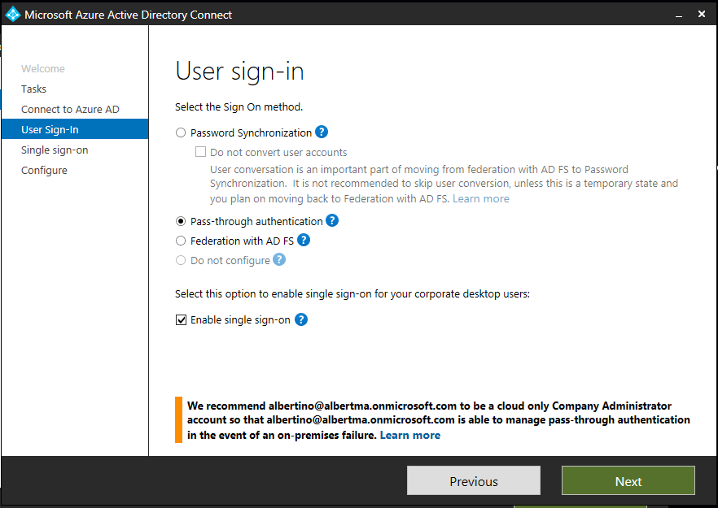
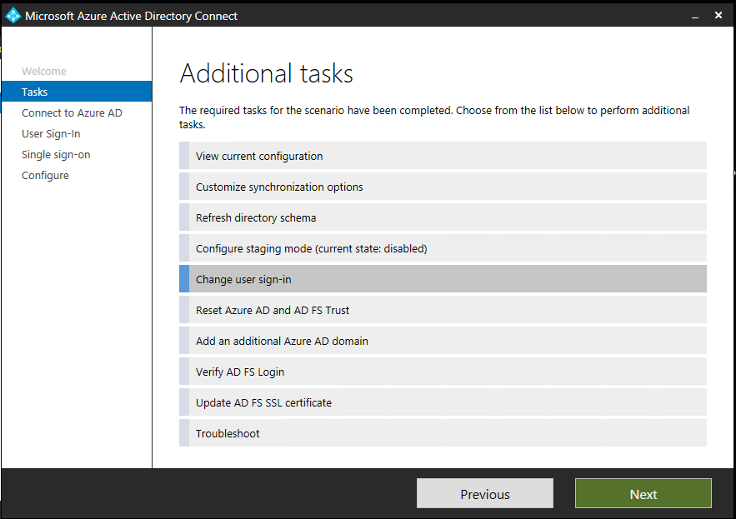
How to enable Seamless SSO
You simply check an “Enable single sign on” checkbox in the custom configuration of the latest version of AD Connect.
New Azure AD Connect installation:
In Azure AD Connect, chose Custom Installation
In “User sign-in” page, check “Enable Single Sign on”
Existing installation:
In Azure AD Connect, chose Change user Sign-in page and click Next
In “User sign in” page, check “Enable single sign on”
For both options:
Continue through the wizard > “Enable single sign on” page > Provide Domain Admin credentials for each AD Forest.
Check status in the Azure Portal
Check for Computer account in Azure AD

Slide 19
Azure AD Connect : User sing-in option for seamless SSO with PHS or PTA
Password Hash Synchronization
combined with seamless SSO
OR
Pass-Through Authentication
combined with seamless SSO
Notes:
https://docs.microsoft.com/en-us/azure/active-directory/connect/active-directory-aadconnect-user-signin
Password hash synchronization with Seamless Single Sign-on (SSO)
Pass-through authentication with Seamless Single Sign-on (SSO)
Federated SSO (with Active Directory Federation Services (AD FS))

Slide 20
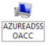

Seamless SSO: How it works
Once the set-up is complete, Seamless SSO works the same way as any other sign-in that uses Integrated Windows Authentication (IWA).
A shadow computer account named AZUREADSSOACCT (which represents Azure AD) is created in your on-premises Active Directory (AD).
The computer account's Kerberos decryption key is shared securely with Azure AD.
In addition, two Kerberos service principal names (SPNs) are created to represent two URLs that are used during Azure AD sign-in.
App
Azure AD
7
Azure AD decrypts Kerberos ticket
3. Kerberos ticket challenge sent
8
8.Azure AD completes the sign-in process
1. Attempt to sign in to app
3
2. User redirected to Azure AD for sign-in
1
6. Browser forwards Kerberos ticket to Azure AD
2
6
The security of your on-premises authentication relies on the integrity of the Kerberos key
It is highly recommend that you roll over the Kerberos decryption key at least every 30 days.
ON-PREMISES
9
9. If sign-in is successful, access the app
AD returns Kerberos ticket
5
4
Request Kerberos ticket from AD
Active Directory
Domain-joined device
Note : For the browser to automatically pass the credential, the Azure AD endpoints must be in the intranet zone
https://autologon.microsoftazuread-sso.com
https://aadg.windows.net.nsatc.net
Notes:
Source: https://docs.microsoft.com/en-us/azure/active-directory/connect/active-directory-aadconnect-sso-how-it-works
How does sign-in with Seamless SSO work?
Once the set-up is complete, Seamless SSO works the same way as any other sign-in that uses Integrated Windows Authentication (IWA).
The flow is as follows:
The user tries to access an application (for example, the Outlook Web App - https://outlook.office365.com/owa/) from a domain-joined corporate device inside your corporate network.
If the user is not already signed in, the user is redirected to the Azure AD sign-in page.
Note: If the Azure AD sign-in request includes a domain_hint (identifying your tenant- for example, contoso.onmicrosoft.com) or login_hint (identifying the user - for example, user@contoso.onmicrosoft.com or user@contoso.com) parameter, then step 2 is skipped.
The user types in their user name into the Azure AD sign-in page.
Using JavaScript in the background, Azure AD challenges the browser, via a 401 Unauthorized response, to provide a Kerberos ticket.
The browser, in turn, requests a ticket from Active Directory for the AZUREADSSOACC computer account (which represents Azure AD).
Active Directory locates the computer account and returns a Kerberos ticket to the browser encrypted with the computer account's secret.
The browser forwards the Kerberos ticket it acquired from Active Directory to Azure AD (on one of the Azure AD URLs previously added to the browser's Intranet zone settings).
Azure AD decrypts the Kerberos ticket, which includes the identity of the user signed into the corporate device, using the previously shared key.
After evaluation, Azure AD either returns a token back to the application or asks the user to perform additional proofs, such as Multi-Factor Authentication.
If the user sign-in is successful, the user is able to access the application.

Slide 21
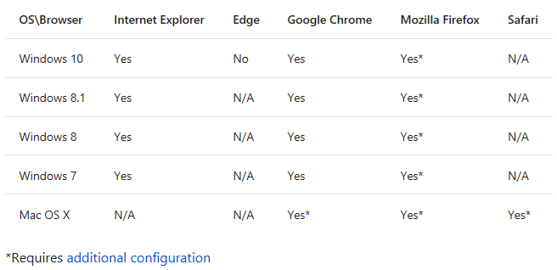
Supported clients
Seamless SSO is supported on web browser-based clients and Office clients that support modern authentication on platforms and browsers capable of Kerberos authentication
Note : For Windows 10, the recommendation is to use Azure AD Join for the optimal single sign-on experience with Azure AD.
Notes:
Additional Configuration:
Firefox: Mozilla Firefox doesn't automatically do Kerberos Authentication. Each user has to manually add the Azure AD URLs to their Firefox settings
MacOS: Must be domain joined
https://docs.microsoft.com/en-us/azure/active-directory/connect/active-directory-aadconnect-sso

Slide 22
federated sign-in
With federated sign-in, your users can sign in to Azure AD-based services with their on-premises passwords. While they're on the corporate network, they don't even have to enter their passwords.
Note : The federated authentication scenario is covered in details in the « Module 4 - Section 4 » which is all about AD FS!
Azure AD supports the use of 3rd party SAML 2.0 Identity Provider (IdP) for Single Sign On
https://docs.microsoft.com/en-us/azure/active-directory/connect/active-directory-aadconnect-federation-saml-idp
For a list of 3rd party Idps that have been tested for use with Azure AD see the Azure AD federation compatibility list
Notes:
https://docs.microsoft.com/en-us/azure/active-directory/connect/active-directory-aadconnect-user-signin#federation-that-uses-a-new-or-existing-farm-with-ad-fs-in-windows-server-2012-r2

Slide 23
Azure AD Connect : User sign-in option for « federation with AD FS »
Provides install & configuration of password sync/ADFS for sign-in
« Federation with AD FS » :
In case where AD FS is configured/managed through Azure AD Connect.
«Do not configure » :
In case where AD FS is configured and managed outside of Azure AD Connect. Or if a 3party federation solution is used.
Notes:
https://docs.microsoft.com/en-us/azure/active-directory/connect/active-directory-aadconnect-user-signin
Password hash synchronization with Seamless Single Sign-on (SSO)
Pass-through authentication with Seamless Single Sign-on (SSO)
Federated SSO (with Active Directory Federation Services (AD FS))

Slide 24
Azure AD and ADFS best practices:
Defending against password spray attacks https://cloudblogs.microsoft.com/enterprisemobility/2018/03/05/azure-ad-and-adfs-best-practices-defending-against-password-spray-attacks/

Slide 25
Authentication Do’s and Don’ts
Do: Make sure the customer understands all the AAD authentication options (and associated limitations/overhead)
Do: Always enable PHS, even if federated
PHS may be used as a backup authentication solution for federated scenario
If your AD FS infrastructure becomes unavailable, you can "switch" to using the synchronized password hashes for user sign-in while you resolve your AD FS incident
The process of switching is done by converting the federated domain back to managed domain (by using the Convert-MsolDomainToStandard cmdlet)
Switching from federated authentication to using synchronized passwords for sign-in is not instantaneous
When AD FS functionality is restored, the domain can be reverted back to federated by running the Convert-MsolDomainToFederated cmdlet (relatively instantaneous)
Do: Always enable Seamless SSO with PHS/PTA
This way, when your users are accessing applications on their corporate machines inside your corporate network, they don't need to type in their passwords to sign in (true SSO).
Do: Deploy more than 1 (PTA) agent for high availability purpose
Don’t: Default to federated
Don’t: Listen to the security guy about PHS being insecure

Slide 27
List of abbreviations
AD: Active Directory (on-premises) AAD: Azure Active Directory
Azure AD: Azure Active Directory
PTA : Pass-Through Authentication
PHS : Password Hash Synchronization
Seamless SSO: Seamless Single Sign-On
LB : Load Balancer
AD FS : Active Directory Federation Services
WAP : Web Application Proxy

